Slide 1



Slide 2

An Android Application for Automobile
Supervised by:
Dr. Yasir Ali Shah
Group Member:
Nabeel Hassan (FA17-BCS-054)
Department of Computer Science
COMSATS University Islamabad, Attock Campus

Slide 3
Outline
Introduction
Related Work
Problem Statement
Objectives
Methodology
Project Design
User Interface
Tools
Conclusion
Future Work
References

Slide 4
Introduction
An Android application for Automobile is a smart android application that is used to provide basic services in automobile field.
This application is a service provider application that provides services including Towing, Fuelling, Repairing, Lock smith and Battery Services.
Similarly, user can contact whenever he needs a towing service to take the vehicle from one place to another in my case of emergency.
This application provides services to the user at low and reasonable price as well as user can easily reach the destination.
The administrator is controlling all operations using admin panel like approving the requests, adding the admin to take care of the system etc.

Slide 5
Introduction
This platform is open for everybody anyone can view the information on it but only the registered users can request the desired service.
The administrator is controlling all operations using admin panel like approving the requests, adding the admin to take care of the system etc.
If any request has any inappropriate information or any social norm is being broken than the administrator can delete the request.

Slide 6
Related Work
In the current time frame, there are two famous web platforms which we found, that deal with this issue of our community.
First platform is most famous one and it is an international organization called AAA (American Automobile Association).
A second web platform is Canadian Automobile Association (CAA).

Slide 7
Related Work
Canadian Automobile Association
The Canadian Automobile Association commonly known as (CAA) is a non-profit federation, founded in 1913, of eight motor clubs across Canada.
Providing roadside assistance service, insurance services, and member discount.
Automobile Association App
Each day the app sends you a list of calls made, and texts exchanged from the phone.
Access your text messages from your computer anytime.
See a clean log of text messages.
Calls with the time they were sent / received with the names from the phone contact list too.

Slide 8
Problem Statement
Driver face tandem of emergency problems of automobile while driving.
Mechanical or electrical fault or run out of Fuel or may be other problems i.e. battery problem, car cleaning etc.
So there is a dire need of system which can help drivers to overcome these problems. So a system (app) is developed which will help the users to get rid of their problems.

Slide 9
Objectives
Provide all the facilities of car related problems that a customer face in long drive.
Provides car services 24/7.
Provide quick response time.
Cost effective.

Slide 10
Methodology
We have chosen Mobile Application Development Lifecycle (MADLC) as we are developing mobile application and Mobile Application Development Lifecycle provides us phases for development.
We used android studio for developing this application.
It is a dedicated framework lifecycle for mobile.
The proposed lifecycle includes the following phases: Identification, Design, Development, Prototyping, Testing and Maintenance.

Slide 11
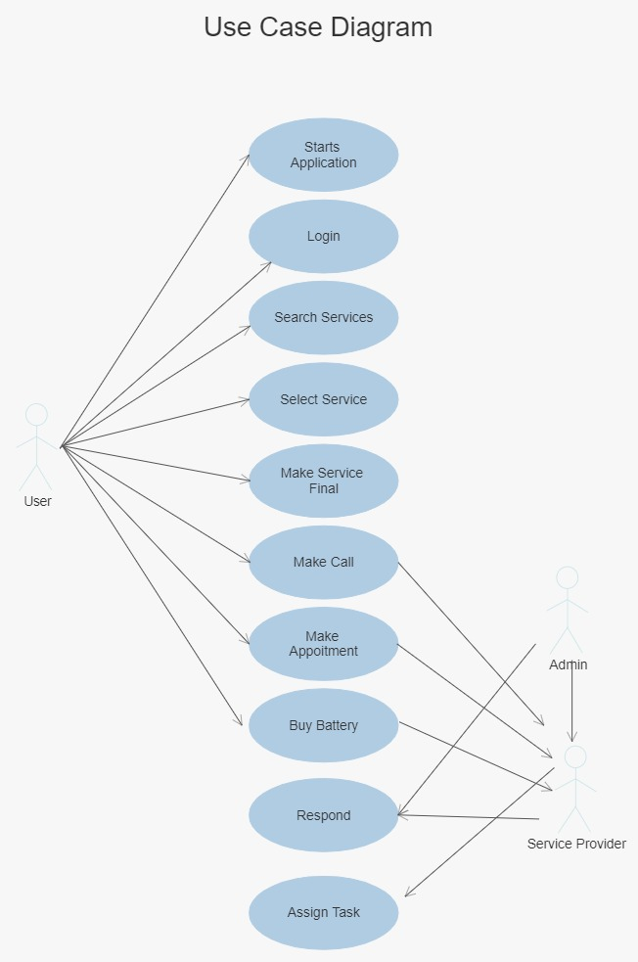
Use Case: User

Slide 12
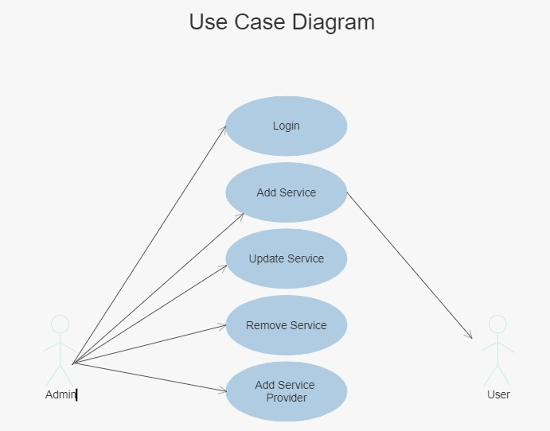
Use case: Admin

Slide 13
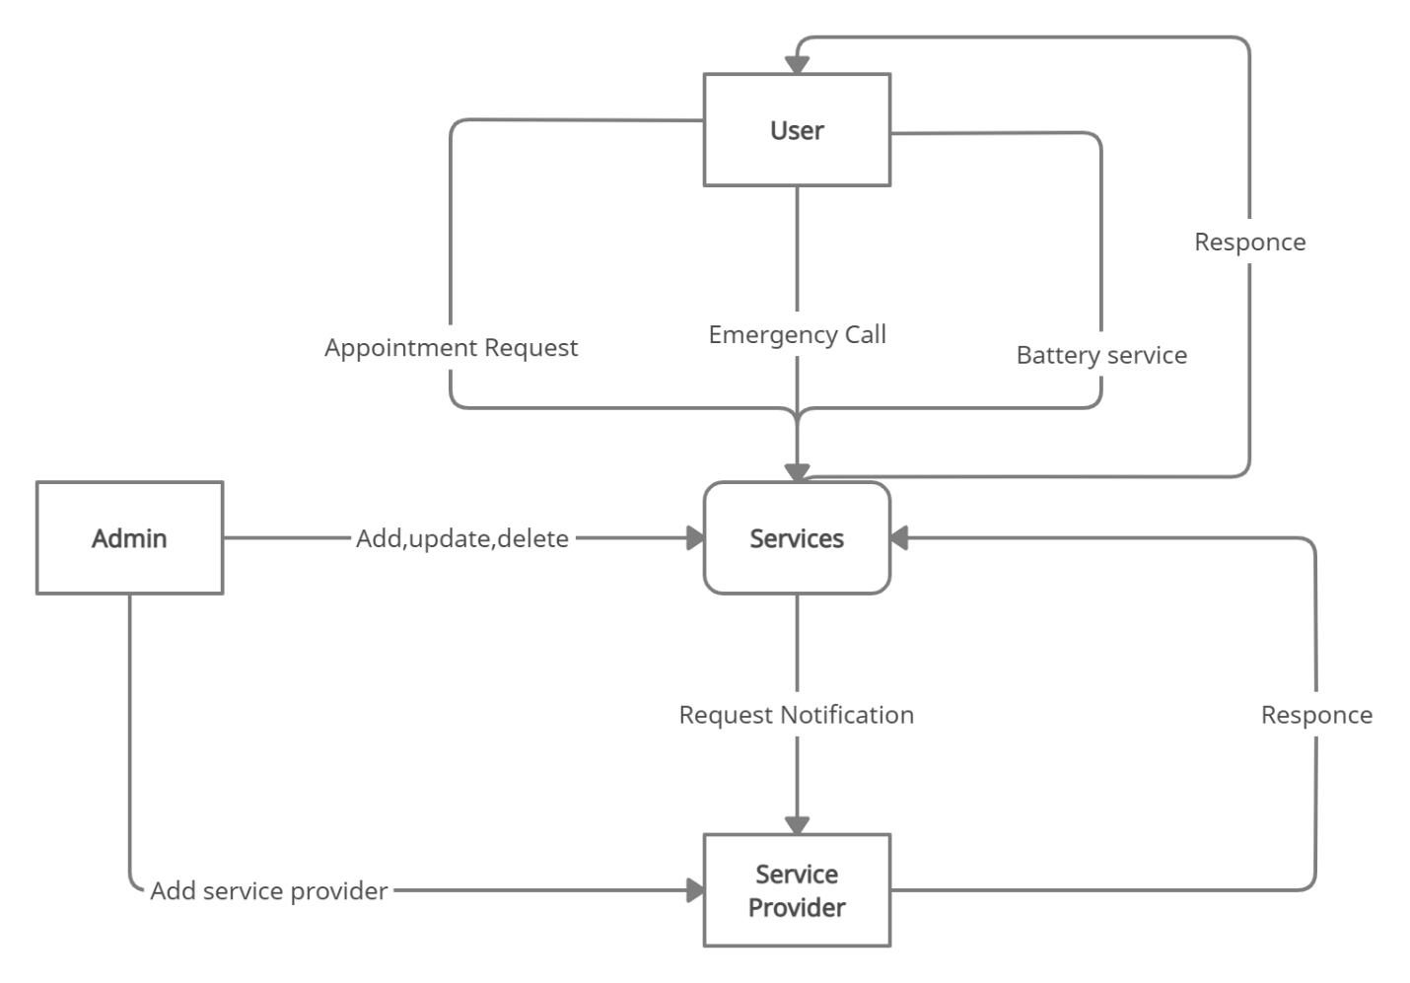
Data flow diagram

Slide 14
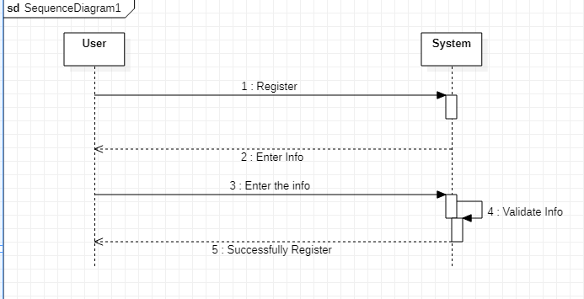
Project Design

Slide 15
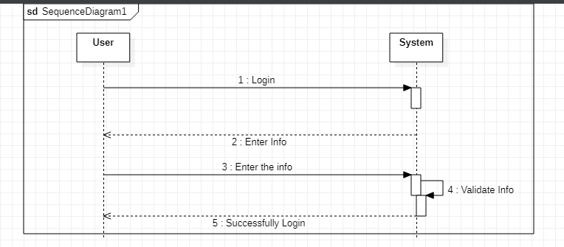
Login

Slide 16
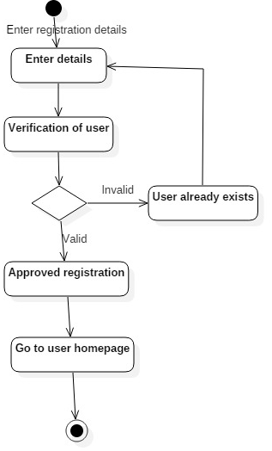
Activity diagrams User Registration

Slide 17
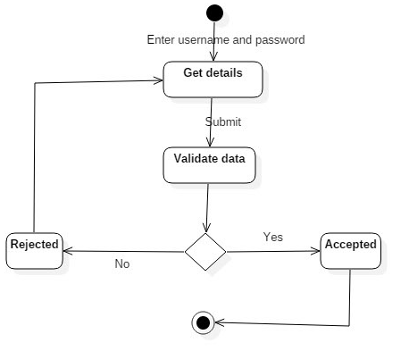
User Login

Slide 18
Admin Login

Slide 19
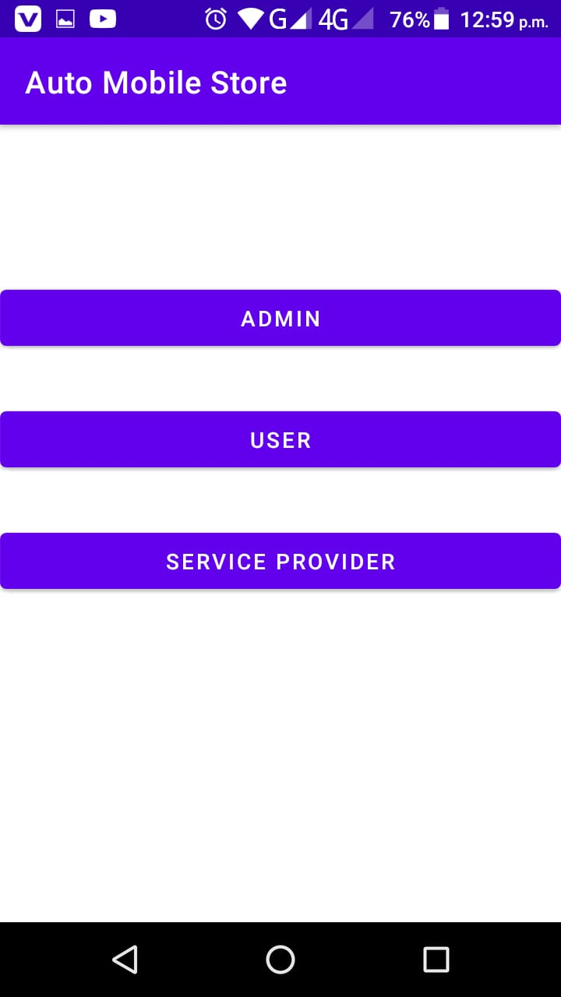
User Interface (Main Display) admin

Slide 20
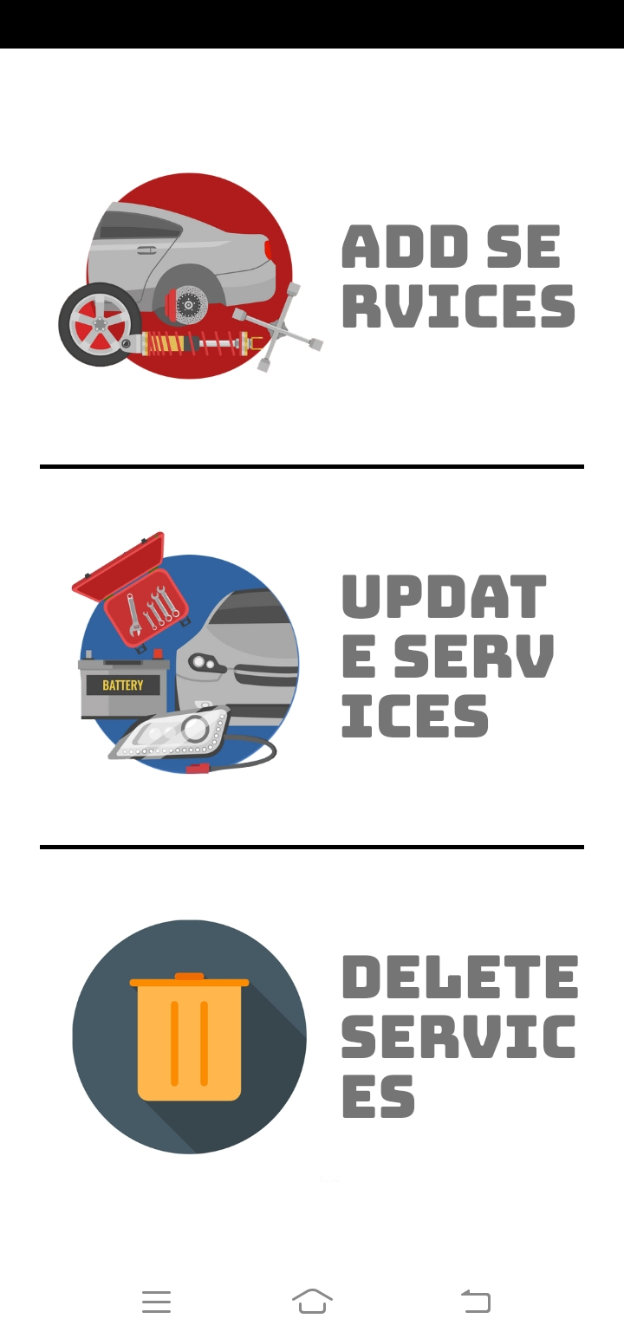
User Interface (Admin)

Slide 21
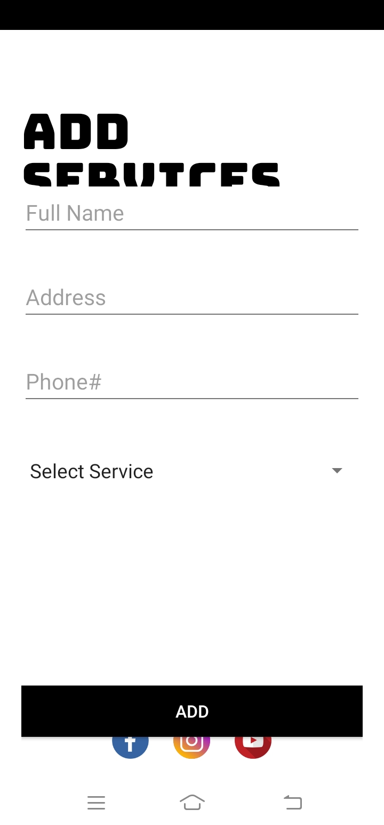
User Interface (Admin add service)

Slide 22
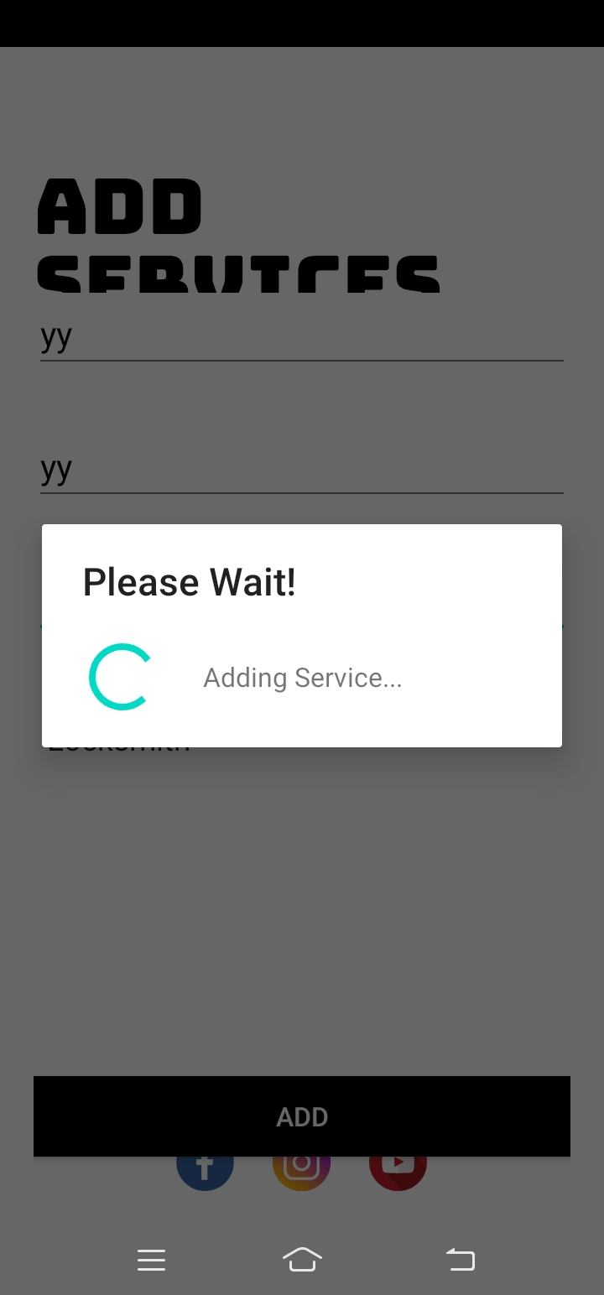
User Interface (Admin Add service of user)

Slide 23
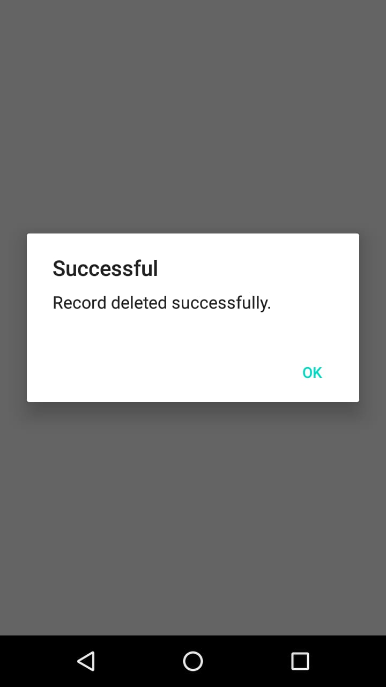
User interface (Admin Delete service)

Slide 24
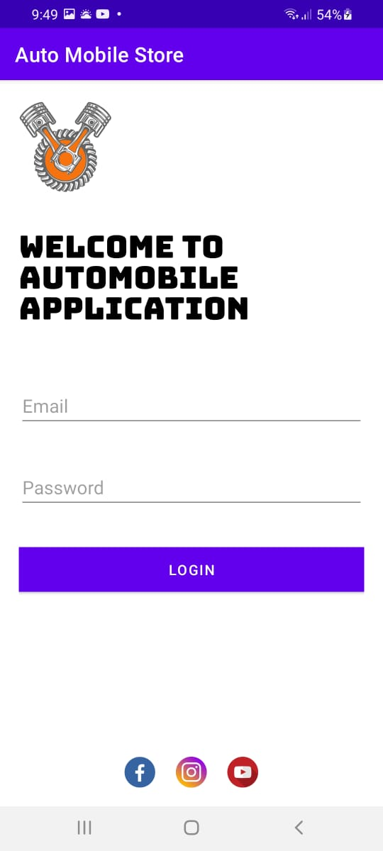
Admin login Display

Slide 25
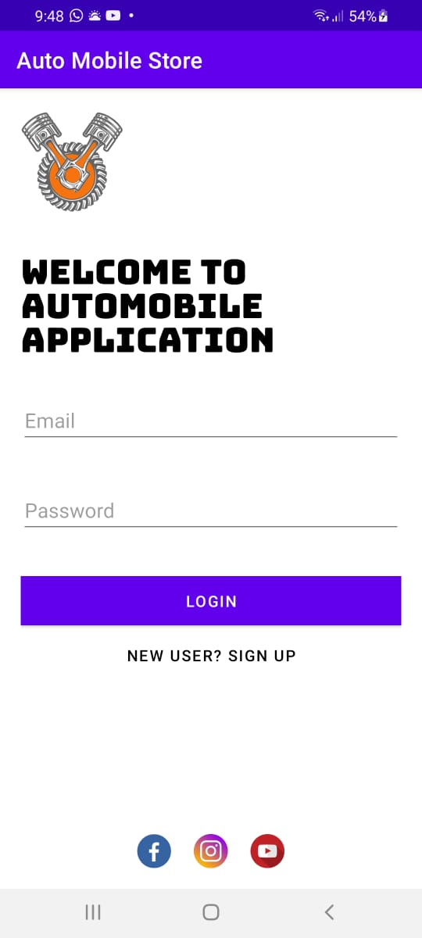
User register/login Display

Slide 26
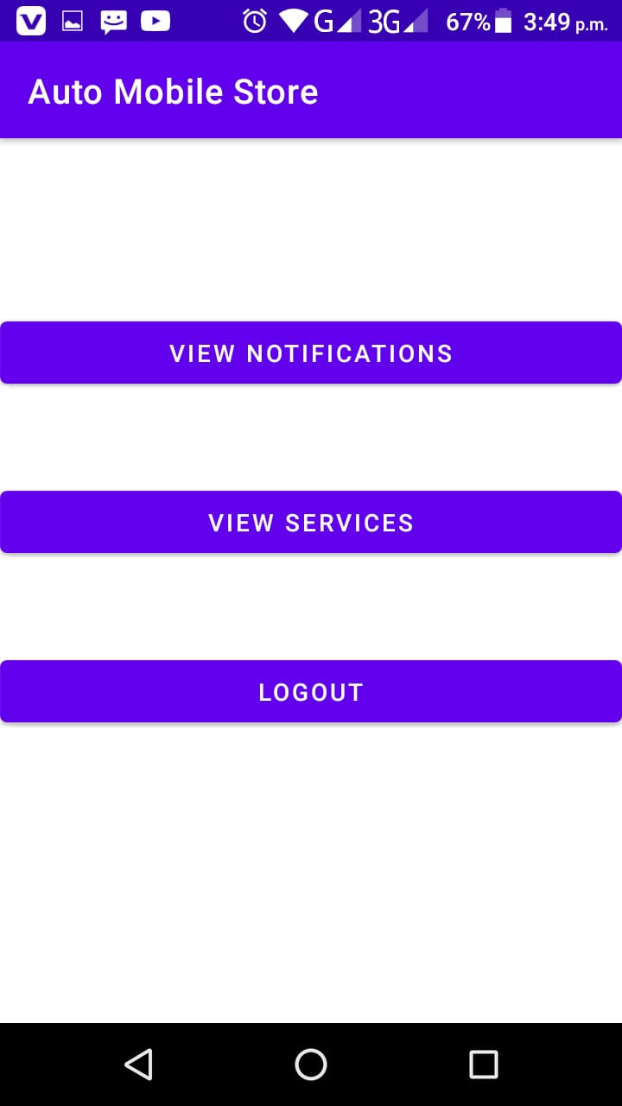
User

Slide 27
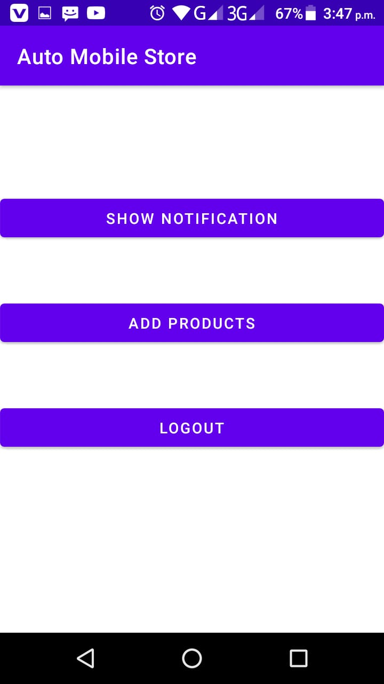
Service provider

Slide 28
Tools
Android Studio
Firebase
MS Word for Documentation.
MS PowerPoint for Presentation slides.

Slide 29
Conclusion
Driver get various problems while driving their automobile, so in order to get them out of this havoc, we had undertaken this very project.
In this project, we developed an Android application based on Automobile services, which will surely help the driver to avail the basic services in automobile field.
This application is a service provider application which help driver to get different services including Towing, Fuelling, Repairing, Lock smith and Battery Services.
Similarly, user can contact whenever he needs a towing service to take the vehicle from one place to another in my case of emergency.

Slide 30
Future Work
We have Next plan to work with GPS and Mobile Location service for both parties and show them over map so that the Service provider and user can coordinate even better.
We can add automobile salesperson feature. User can easily buy and sell a car in one platform.
We are hiring mechanics, locksmith persons and tire related persons who are specialized in these fields.

Slide 31
References
https://en.wikipedia.org/wiki/Android_Studio
https://www.javatpoint.com/android-intent-tutorial#:~:text=Android%20Intent%20is%20the%20message,intent%20is%20intention%20or%20purpose
https://en.wikipedia.org/wiki/XAMPP
https://en.wikipedia.org/wiki/Kotlin_(programming_language)
https://en.wikipedia.org/wiki/Java_(programming_language)
https://www.javatpoint.com/android-intent-tutorial#:~:text=Android%20Intent%20is%20the%20message,intent%20is%20intention%20or%20purpose
https://www.w3schools.com/sql/sql_intro.asp
https://docs.microsoft.com/en-us/sql/ssms/quickstarts/ssms-connect-query-sql-server?view=sql-server-ver15
https://docs.microsoft.com/en-us/sql/relational-databases/lesson-1-connecting-to-the-database-engine?view=sql-server-ver15

